Slide 1
Real World Application of DAA
Maze problem
Using DFS algorithm
Submitted by :
Alok Kumar Sah
RA2211031010180
CSE-IT(4th Semester)
U2 section
Mukund Hariharan
RA2211031010181
CSE-IT(4th Semester)
U2 section

Slide 2
Problem Statement
In the ever-evolving landscape of computer science, the significance of efficient maze-solving algorithms is undeniable. However, the complexities inherent in comprehending and teaching the intricacies of depth-first search (DFS) for maze solving pose substantial challenges. The abstract nature of these algorithms often creates a cognitive barrier, impeding learners from grasping the fundamental workings of DFS. Traditional educational methods, with their static representations and lack of interactive learning experiences, struggle to foster enthusiasm and effective understanding of maze-solving algorithms.

Slide 3
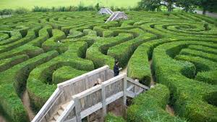
Introduction:
The "DEPTH-FIRST SEARCH FOR MAZE SOLVING" is a data structure algorithm implementation designed to solve mazes efficiently using the depth-first search (DFS) technique. The project aims to explore and demonstrate the application of DFS, a fundamental graph traversal algorithm, in solving maze structures. By utilizing DFS, the algorithm systematically explores possible paths within a maze, providing a solution to navigate from the start to the destination.

Slide 4
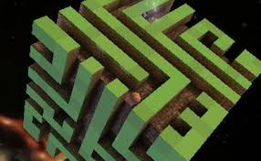
Objective:
To implement the principles and applications of the depth-first search algorithm in maze solving as a real world application.
To provide insights into how the algorithm efficiently explores and navigates mazes.

Slide 5
Pseudocode
// Define constant for maximum maze size
MAX_SIZE = 100
// Function to perform Depth-First Search for maze solving
function dfsMazeSolver(maze[MAX_SIZE][MAX_SIZE], rows, cols, x, y):
if (x < 0 || x >= rows || y < 0 || y >= cols || maze[x][y] == '0' || maze[x][y] == 'V'):
return 0 // Cannot move to this position
if (maze[x][y] == 'E'):
return 1 // Exit found
if (maze[x][y] == 'S'):
maze[x][y] = 'S'
original = maze[x][y]
maze[x][y] = 'V'
if (dfsMazeSolver(maze, rows, cols, x - 1, y) || dfsMazeSolver(maze, rows, cols, x + 1, y) ||
dfsMazeSolver(maze, rows, cols, x, y - 1) || dfsMazeSolver(maze, rows, cols, x, y + 1)):
return 1 // Path found
maze[x][y] = original
return 0 // No path found from this position

Slide 6
// Function to display the maze
function displayMaze(maze[MAX_SIZE][MAX_SIZE], rows, cols):
for i from 0 to rows - 1:
for j from 0 to cols - 1:
if (maze[i][j] == 'V'):
print("* ")
else if (maze[i][j] == 'S'):
print("S ")
else:
print(maze[i][j] + " ")
print("\n")
// Function to convert lowercase 's' to 'S' and 'e' to 'E'
function convertToLowercase(maze[MAX_SIZE][MAX_SIZE], rows, cols):
for i from 0 to rows - 1:
for j from 0 to cols - 1:
if (maze[i][j] == 's'):
maze[i][j] = 'S'

Slide 7
else if (maze[i][j] == 'e'):
maze[i][j] = 'E'
// Function to check if at least one start and one exit point are present
function checkStartAndExit(maze[MAX_SIZE][MAX_SIZE], rows, cols):
startCount = 0
exitCount = 0
for i from 0 to rows - 1:
for j from 0 to cols - 1:
if (maze[i][j] == 'S'):
startCount++
else if (maze[i][j] == 'E'):
exitCount++
if (startCount == 0 || exitCount == 0):
return 0 // At least one start and one exit point are not present
return 1 // Both start and exit points are present

Slide 8
// Main function
function main():
exampleMaze = {...} // Define an example maze
exampleSolution = {...} // Define the solution for the example maze
exampleRows = 4
exampleCols = 5
print("Example Maze:")
displayMaze(exampleMaze, exampleRows, exampleCols)
print("\n")
print("Example Solution:")
displayMaze(exampleSolution, exampleRows, exampleCols)
print("\n")
maze[MAX_SIZE][MAX_SIZE]
rows, cols = input("Enter the number of rows in the maze: "), input("Enter the number of columns in the maze: ")
print("Enter the maze (S for start, E for exit, 1 for path, 0 for wall):")

Slide 9
for i from 0 to rows - 1:
for j from 0 to cols - 1:
input = input("Enter value for maze[i][j]: ")
if (input == 's' || input == 'e'):
input = (input == 's') ? 'S' : 'E'
if (!(input == 'S' || input == 'E' || input == '1' || input == '0')):
print("Error: Invalid input. Only 'S', 'E', '1', or '0' are allowed.")
return
maze[i][j] = input
convertToLowercase(maze, rows, cols)
if (!checkStartAndExit(maze, rows, cols)):
print("Error: At least one start ('S') and one exit ('E') point are required.")
return
print("\nInitial Maze:")
displayMaze(maze, rows, cols)
if (dfsMazeSolver(maze, rows, cols, 0, 0)):
print("Path found!")
displayMaze(maze, rows, cols)
else:
print("No path found.")

Slide 10
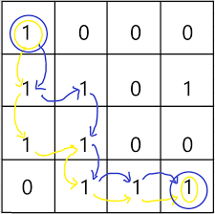
Dry Run

Slide 11
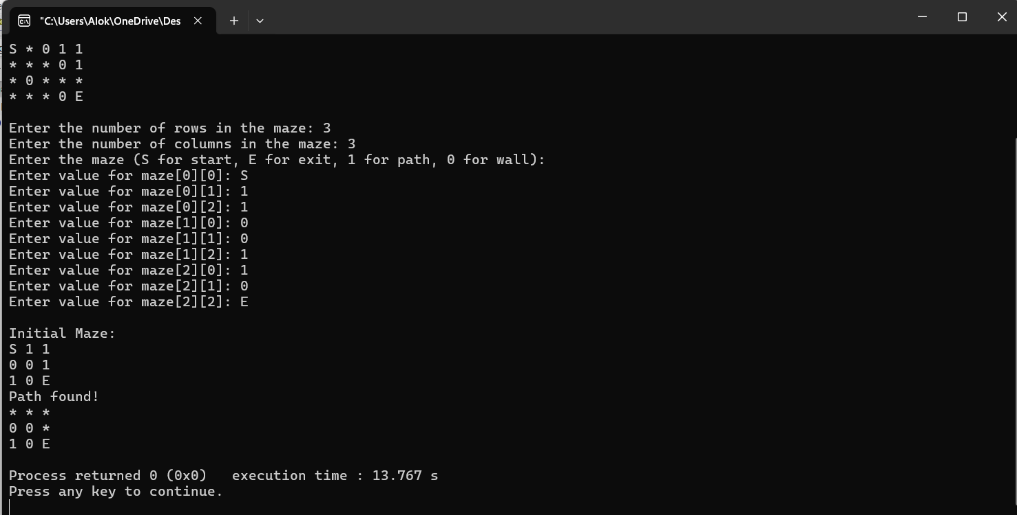
Sample Input Output(Screenshot)

Slide 12
Time Complexity Analysis
For a Maze:
In the context of a maze represented as a 2D grid with n rows and m columns, the time complexity can be expressed as O(n*m).
The reason for this is that DFS visits each cell of the maze exactly once.
Let T(n,m) represent the time complexity of solving a maze of size n×m.
In each step of the DFS algorithm, we visit each cell of the maze at most once. Therefore, the time complexity at each step can be considered as constant. Let's denote this constant time as c.
The number of cells in the maze is n×m, so the total number of steps taken to solve the maze is proportional to the number of cells visited.

Slide 13
Time Complexity Analysis
Thus, we can write the recurrence relation as follows:
T(n,m)=c*(n*m)
Where:
c is a constant representing the time taken to process each cell.
n is the number of rows in the maze.
m is the number of columns in the maze.
Now, let's analyze this recurrence relation to find the time complexity:
Each cell in the maze is visited exactly once during the DFS traversal.
Therefore, the time complexity of solving the maze using DFS is O(n*m).
So, the time complexity of the maze problem solution using DFS is O(n*m), where n is the number of rows and m is the number of columns in the maze.

Slide 14
Space Complexity Analysis
The space complexity of the program is proportional to the maximum depth of recursion, which is O(n*m), where n is the number of rows and m is the number of columns in the maze.

Slide 15
Conclusion:
Thus, DFS algorithm was implemented to solve a real world problem i.e. Maze Probelm.

